Slide 1
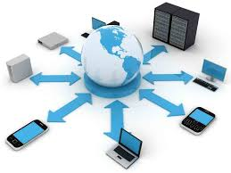
Transport Layer
Computer Communication and Networks
Session 16
Tutor: Karma Wangchuk

Slide 2
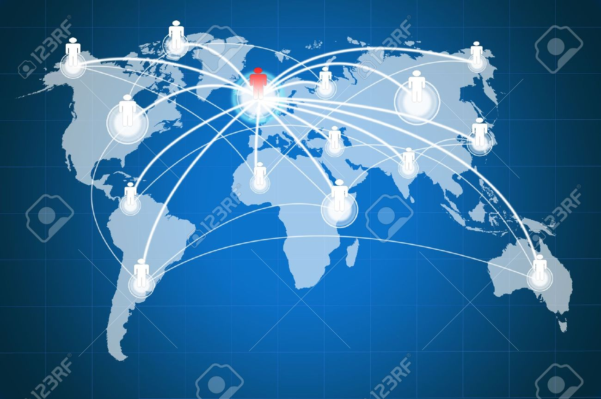
Transport Layer
Learning Outcomes: At the end of the lesson, you are expected to be able to:
  Introduction
  User Datagram Protocol (UDP)
    UDP Datagram format
  Port Numbers
  Transmission Control Protocol (TCP)
    TCP Datagram format
  Types of addresses used by TCP/IP

Slide 3
Transport Layer
Introduction:
Whenever we need to deliver something to one specific destination among many, we need to address:
    At the data link layer, we need a MAC address to choose one node among several nodes if the connection is not point-to-point.
    At the network layer, we need an IP address to choose one host among millions
    At the transport layer, we need a transport layer address called a Port Number (Port Address).

Slide 4
Transport Layer
Port Number:
16-bits port number ranges from 0 to 65535
  IANA (Internet Assigned Number Authority) divides the addresses into three ranges:
    Well-known port
    Registered ports
    Dynamic ports

Slide 5
Transport Layer
Port Number:
Well-known ports:
  Ranges from 0 to1023, assigned and controlled by IANA
Registered ports:
  It ranges from 1024 to 49151, not assigned and controlled by IANA
  They can only be registered with IANA to prevent duplication
Dynamic ports:
  The ports ranging from 49152 to 65535 are neither controlled by IANA nor registered.
  Used temporary or private port numbers

Slide 6
Transport Layer
Transport layer Protocols:
Several application programs (processes) simultaneously running on a source host has to communicate with corresponding processes running on the remote destination host through the internet.
There is a need for an additional mechanism and is called process-to-process delivery.
  Process-to-process delivery of segments in the transport layer takes place through an address known as the port number.

Slide 7
Transport Layer
Transport layer Protocols:
There are several ways to achieve process-to-process communication
  The most common one is the Client/Server paradigm.
A process on the localhost, called a Client, needs services from a process usually on the remote host, called a Server.

Slide 8
Transport Layer
Socket Addresses:
  Process-to-process delivery needs two identifiers, IP address and the port number, at each end to make a connection.
    The combination of an IP address and a port number is called a Socket address.
  The Client socket address defines the client process uniquely just as the server socket address defines the server process uniquely.

Slide 9
Transport Layer
Socket Addresses:
  A Transport layer protocol needs a pair of socket addresses:
    The Client socket address
    The Server socket address
  The internet has two main protocols in the transport layer:
    Connectionless protocol (UDP)
    Connection-oriented protocol (TCP)
  A new transport-layer protocol, SCTP, has been designed.

Slide 10
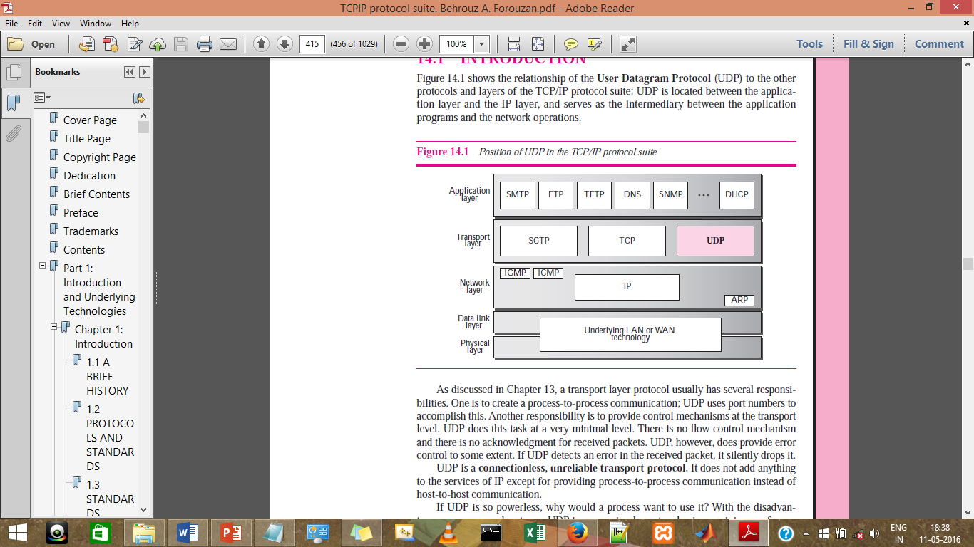
Transport Layer: User Datagram Protocol (UDP)
User Datagram Protocol:
  The relationship of the UDP to the other protocols and layers of the TCP/IP protocol suite:
    UDP is located between the application layer and the IP layer, and serves as the intermediary between the application programs and the network operations.

Slide 11
Transport Layer: User Datagram Protocol (UDP)
User Datagram Protocol:
  A transport layer protocol usually has several responsibilities.
    One is to create a process-to-process communication;
      UDP uses port numbers to accomplish process-to-process communication.
    Another responsibility is to provide control mechanisms at the transport level.
      UDP does this task at a very minimal level.
    There is no flow control mechanism and there is no acknowledgment for received packets.
    UDP, however, does provide error control to some extent.
      If UDP detects an error in the received packet, it silently drops it.

Slide 12
Transport Layer: User Datagram Protocol (UDP)
User Datagram Protocol:
UDP is called a connectionless, unreliable transport protocol.
It does not add anything to the services of IP except to provide process-to-process communication instead of host-to-host communication.
It performs very limited error checking.
If UDP is so powerless, why would a process want to use it?
  UDP is a very simple protocol using a minimum of overhead. If a process wants to send a small message and does not care much about reliability, it can use UDP.
  Sending a small message by UDP takes much less interaction between the sender and receiver than TCP

Slide 13
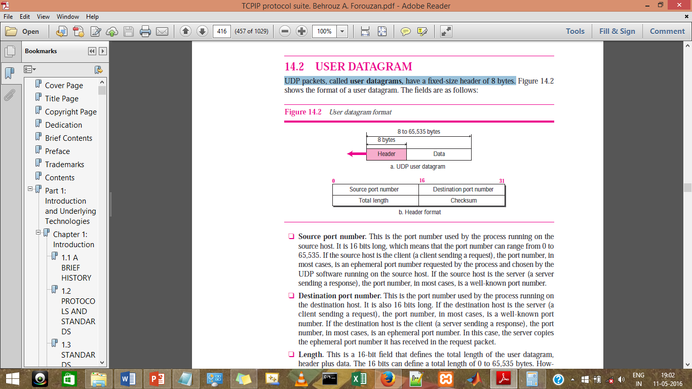
Transport Layer: UDP Ports
UDP Datagram Format:
UDP packets are called user datagrams and have a fixed-size header of 8 bytes.
  Source port number. This is the port number used by the process running on the source host. It is 16 bits long, which means that the port number can range from 0 to 65,535.

Slide 14
Transport Layer: UDP Ports
UDP Datagram Format:
  Destination port number. This is the port number used by the process running on the destination host. It is also 16 bits long.

Slide 15
Transport Layer: UDP Ports
UDP Datagram Format:
  Length. This is a 16-bit field that defines the total length of the user datagram, header plus data.
  Checksum. This field is used to detect errors over the entire user datagram (header plus data).

Slide 16
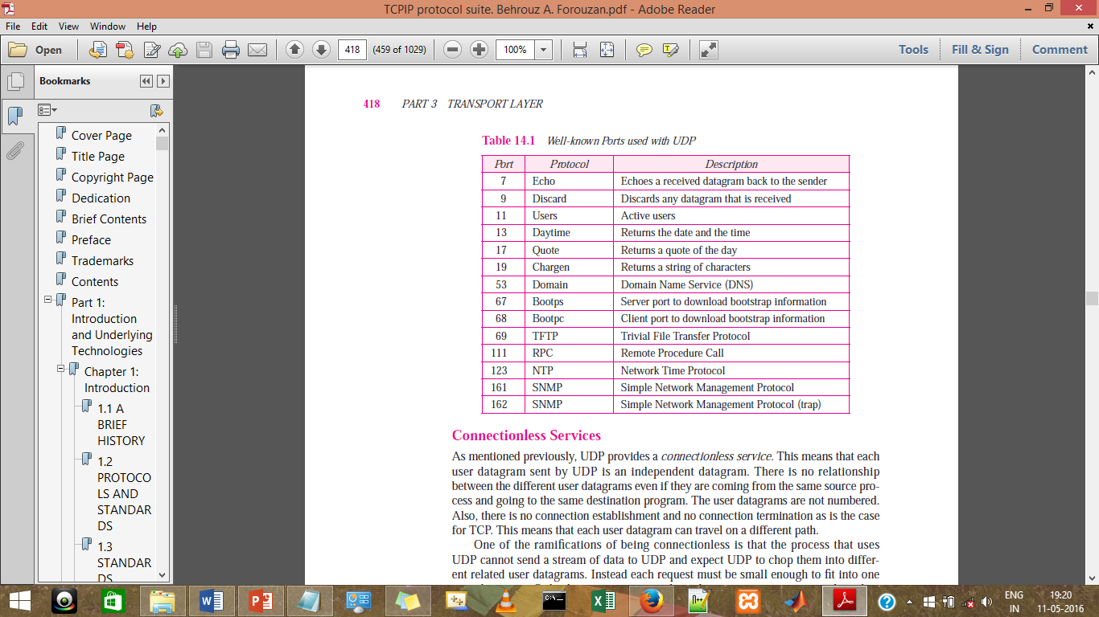
Transport Layer: UDP Ports
Well-Known Ports used by UDP:

Slide 17
Transport Layer
Services provides by UDP:
  Process-to-process Communication
  Connectionless Services
  Flow Control
  Error Control
  Congestion Control
  There is no error control mechanism in UDP except for the checksum.
    This means that the sender does not know if a message has been lost or duplicated.
      When the receiver detects an error through the checksum, the user datagram is silently discarded.

Slide 18
Transport Layer
Characteristics of UDP:
  Provides unreliable connectionless delivery service using IP to transport messages between two processes.
  UDP messages can be lost, duplicated, delayed and can be delivered out of order.
  UDP is a thin protocol (no significant functionality added to IP)
  It cannot provide reliable stream transport service.
  Guess what Protocol overcomes this limitation?
  ???.
  http://www.gripinit.com/2015/03/29/udp-theory/

Slide 19
Transport Layer
Transmission Control Protocol:
TCP provides reliable, full-duplex, stream delivery service using IP to transport messages between two processes.
Reliability is ensured by:
    Connection oriented services
    Flow control using sliding window protocol
    Error detection by Checksum
    Error control by go-back-NARQ technique.
    Congestion avoidance algorithms ,such as slow-start, multiplicative decrease.

Slide 20
Transport Layer
TCP Datagram Format:

Slide 21
Transport Layer
Three types of addresses used by TCP/IP:

Slide 22
Transport Layer
Well-Known Ports used by TCP:

Slide 23
Transport Layer
Services Provided by TCP:
  Process-to-process Communication
  Stream Delivery Service
  Connection-Oriented Service
  Flow Control
  Error Control
  Control Congestion

Slide 24
Transport Layer
Services Provided by TCP
  Connection-Oriented Service
    TCP, unlike UDP, is a connection-oriented protocol. When a process at site A wants to send to and receive data from another process at site B, the following three phases occur:
      The two TCPs establish a virtual connection between them.
      Data are exchanged in both directions.
      The connection is terminated.

Slide 25
Transport Layer
Stream Control Transmission Protocol
  SCTP is designed as a general-purpose transport layer protocol that can handle multimedia and stream traffic, which are increasing every day on the Internet.
  SCTP, however, is mostly designed for Internet applications that have recently been introduced and need a more sophisticated service than TCP can provide.
    These new applications, such as:
      IUA (ISDN over IP),
      M2UA and M3UA (telephony signalling),
      H.248 (media gateway control),
      H.323 (IP telephony), and
      SIP (IP telephony).

Slide 26
Transport Layer
SCTP
Service Provided by the SCTP:
    Process-to-Process Communication
    Connection-Oriented Service
    Full-duplex Communication
    Multi-homing Service
    Multi-Stream Service

Slide 27
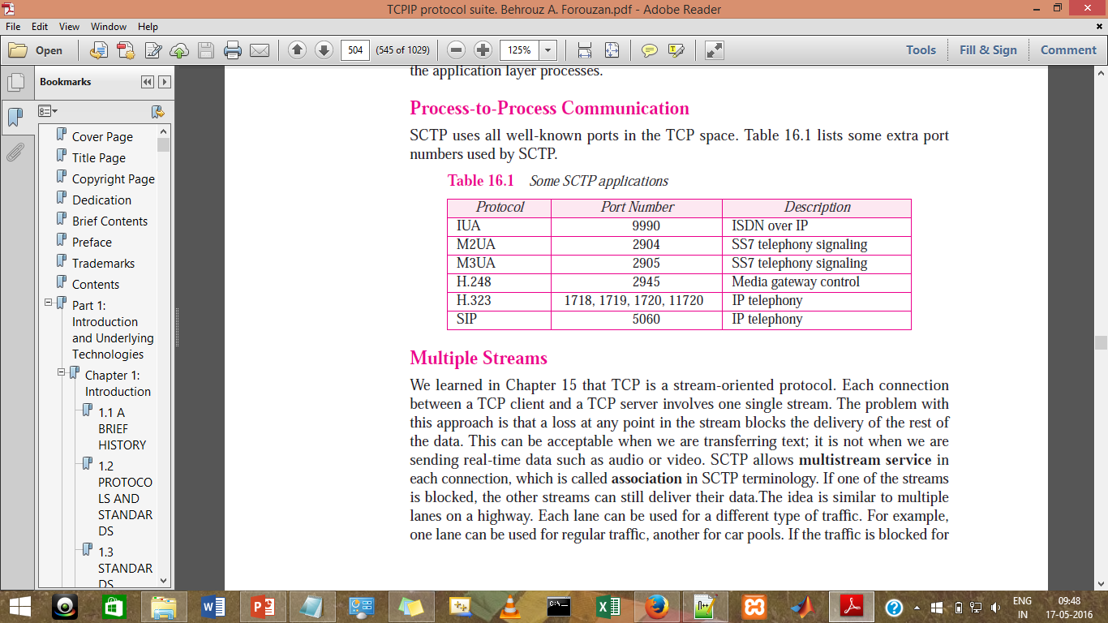
Transport Layer
Well-Known Ports used by SCTP:

Slide 28
Recapitulation
We have learned:
  Introduction
  User Datagram Protocol (UDP)
    UDP Datagram format
  Port Numbers
  Transmission Control Protocol (TCP)
    TCP Datagram format
  Types of addresses used by TCP/IP
  Stream Control Transmission Protocol

Slide 29
References
References:
  Stallings, W., Data & Computer Communication, Prentice-Hall
  Tanenbaum, Computers Networks, PHI
  Forouzan, B.A., Data Communication & Networkings, 4th Edition.
  Mr. Yeshi Wangchuk’s CCN Class Slides (2014), College of Science and Technology, Rinchending, Phuentsholing, Bhutan

Slide 30
See you in next class.

